Slide 1
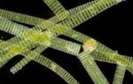
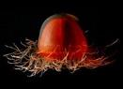
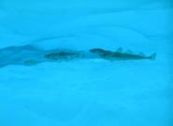
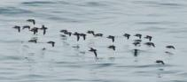
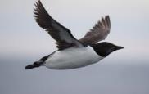
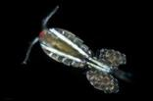
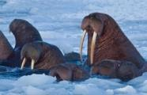

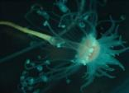
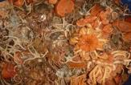
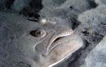
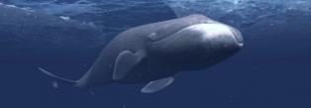









FROM MICROBES TO WHALES
AMBON: Linking biodiversity observations in the Arctic
Katrin Iken¹, Lee Cooper², Seth Danielson¹, Matt Galaska³, Jacqueline Grebmeier², Donna Hauser¹, Russ Hopcroft¹, Maria Kavanaugh⁴, Kathy Kuletz⁵, Franz Mueter¹, Kate Stafford⁴, Sheyna Wisdom⁶, Alex Whiting⁷
(1) University of Alaska Fairbanks, (2) University of Maryland Center for Environmental Sciences, (3) University of Washington/NOAA, (4) Oregon State University, (5) U.S. Fish and Wildlife Service, (6) Alaska Ocean Observing System, (7) Native Village of Kotzebue

Slide 2
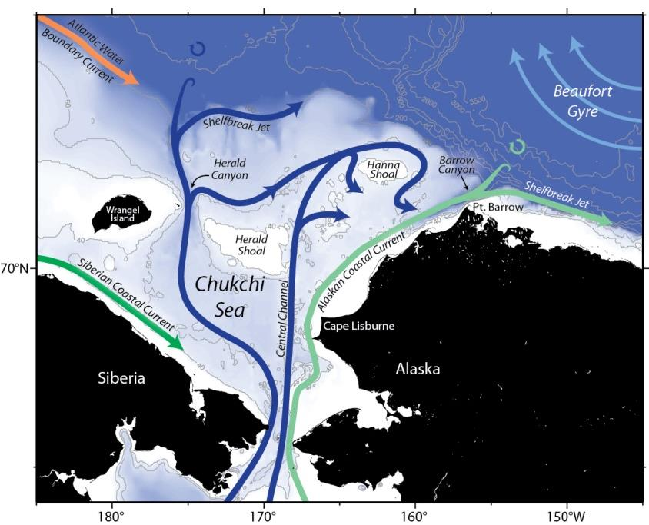
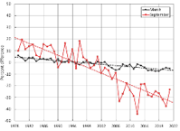
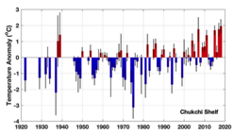
Why the Chukchi Sea?
Highly productive Arctic shelf
High rate of climate change
Sentinel species
Subsistence harvest region
Potential fisheries interest
Increased vessel traffic
Oil & gas potential
Problems:
Accessibility (ice cover)
Cost
Complexity

Slide 3
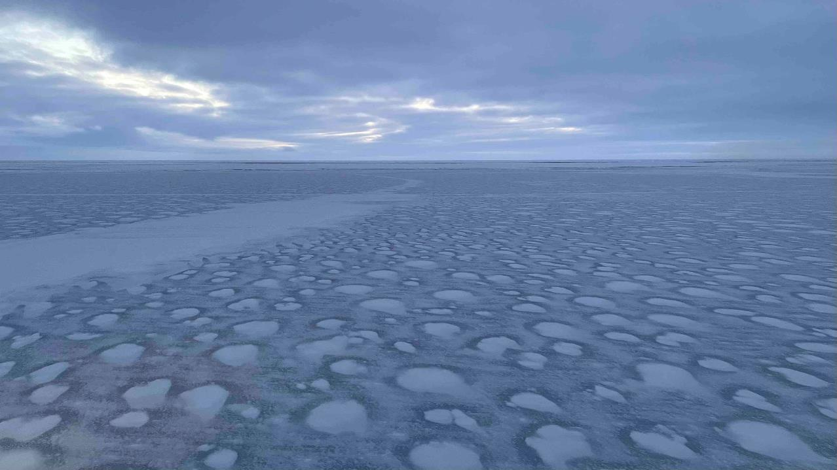
AMBON goals
Provide high-quality biodiversity data from the Chukchi Sea across trophic levels, from microbes to whales
Linking multiple approaches to groundtruth the use of eDNA for monitoring marine mammal presence or abundance
Relate seascapes derived from a Pacific Arctic Regional Ocean Model to associations of taxa
Meaningfully bridge Indigenous and scientific knowledge systems and management goals
Provide an Arctic perspective to the national MBON initiative
Open access data management
Provide useful and actionable stakeholder information

Slide 4
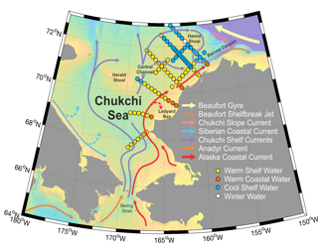


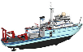
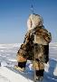

AMBON “design”
Long-term moorings (CEO)
Space
Vessel-based surveys
Coastal observations
Time

Slide 5
AMBON “design”
Space
Time

Slide 6
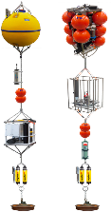







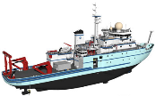
AMBON “design”
Passive acoustic marine mammal recorder
Marine mammal sound
Water sampler / water sampling
eDNA marine mammals
Example: Linking multiple ways to detect marine mammal and other taxa
Marine mammal observers / coastal observers
Marine mammal sightings

Slide 7
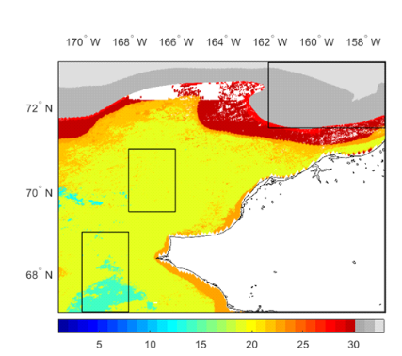

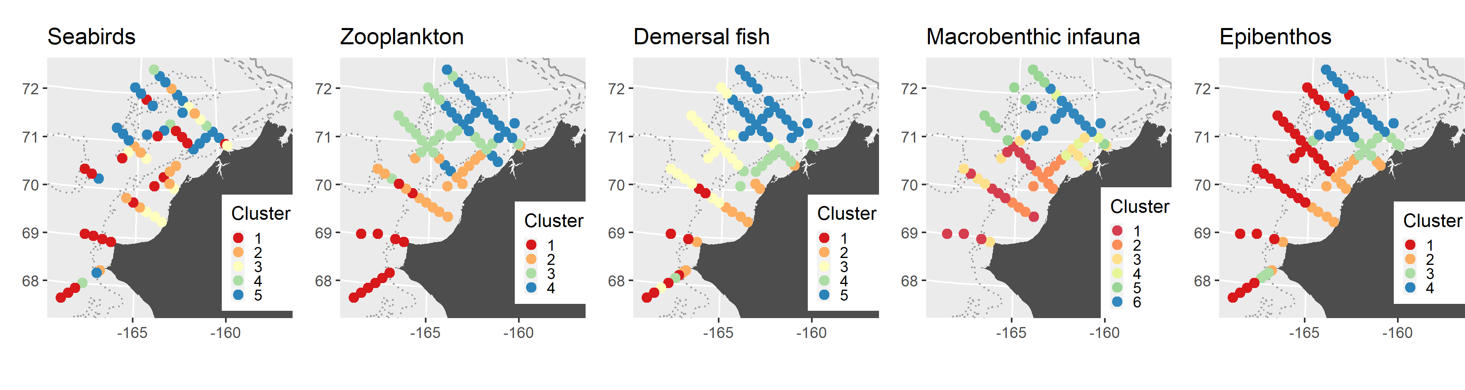
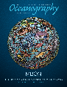
AMBON “design”
Regional model
Limitation of satellite-derived data in the Arctic, especially in shoulder seasons
Use available data from PAROMS model instead
Create spatially explicit outputs (southern and northern Chukchi Sea)
Example: Regionally downscaled seascapes in relation to species distribution
Variables: chl-a,
CDOM, normalized fluorescent line height,
SST, salinity, sea surface height, sea-ice conc. from ROMS model
Keeping engaged with Northern California Current MBON
Seabirds
Zoopl.
Fish
Infauna
Epifauna
Mueter et al. 2021

Slide 8

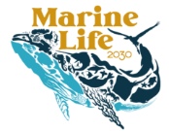

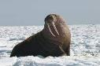
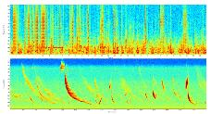
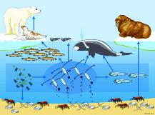
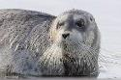
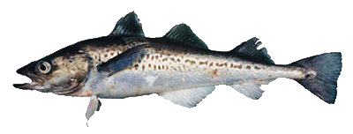


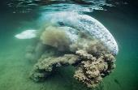
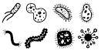
AMBON as part of a network
Provide an Arctic perspective to the national MBON initiative
Targeted Essential Ocean Variables (EOV)
Value of working groups
Soundscapes
eDNA
BEF
Data management
Biological traits analysis
Standardize across MBON regions

Slide 9
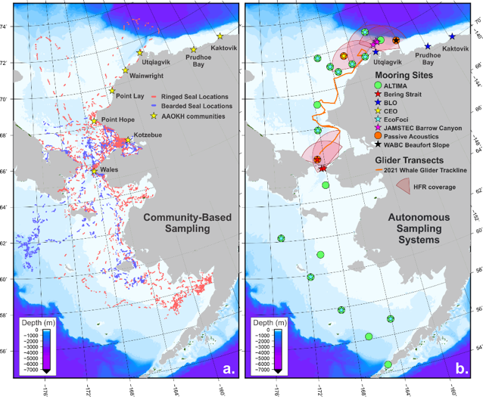
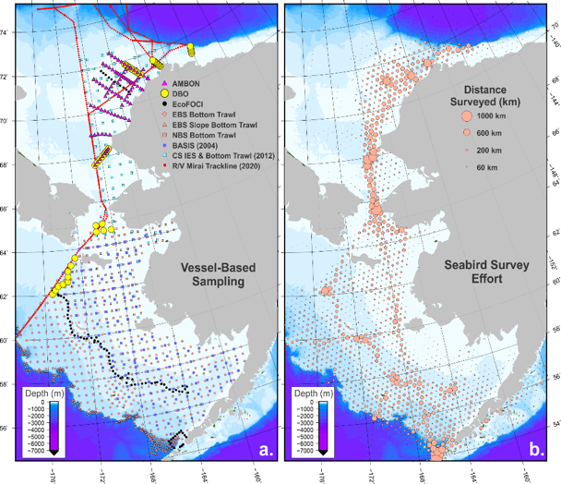
AMBON as part of a network
Community based
Autonomous
Vessel based
Seabird Observing
Danielson, Iken et al. 2022

Slide 10
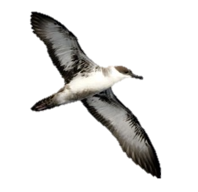
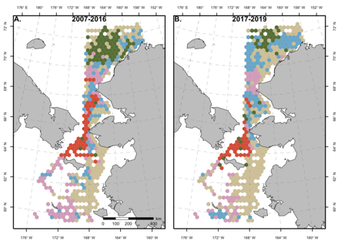

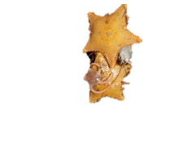
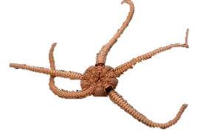
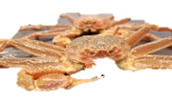
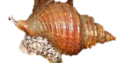
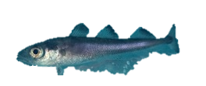
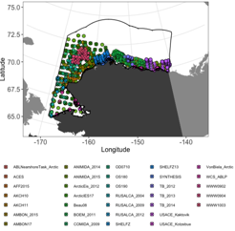
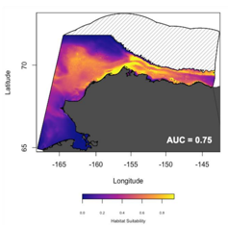
AMBON as part of a network
Goal: harmonizing / collating long-term data
Long-term trend analyses, forecasting
Cross-taxa analyses (MBON special issue)
Data accessibility (databases, publications)
Kuletz et al. 2020
Juv. Arctic cod
Sutton, Iken, Mueter et al. subm.
Marsch, Mueter et al. 2021

Slide 11



AMBON management applications
NPFMC's Scientific and Statistical Committee
Provide statistically sound advise and scientific data to fisheries management in the North Pacific and Arctic
NEPA needs by management agencies
Spatial planning, invasive species
Arctic Integrated Ecosystem Assessment (IEA) of the NBS/CS
Organized by the North Pacific Marine Science Organization (PICES) as WG44
Completion during AMBON project duration
Interagency Arctic Research Policy Committee (IARPC)
Coordination of Arctic activities across US federal agencies
Marine Ecosystem Collaboration Team under the new US 5 yr Arctic Research Plan 2022-2026

Slide 12
AMBON local management links
Food security: subsistence food and commercial fisheries
Subsistence users of local foods
Marine mammals, seabirds, tunicates, clams, crabs, fish
Negative impact of toxic algae (Harmful Algal Blooms) and ocean acidification on key food organisms
Partnership with local
observers
2-way information
exchange
Commercial fisheries
Pollock and Pacific cod in the Bering Sea, large US fisheries
Expanding northward with warming seawater
Monitoring of AMBON region north of Bering Strait essential e.g., migration frequencies, establishment of new populations

Slide 13
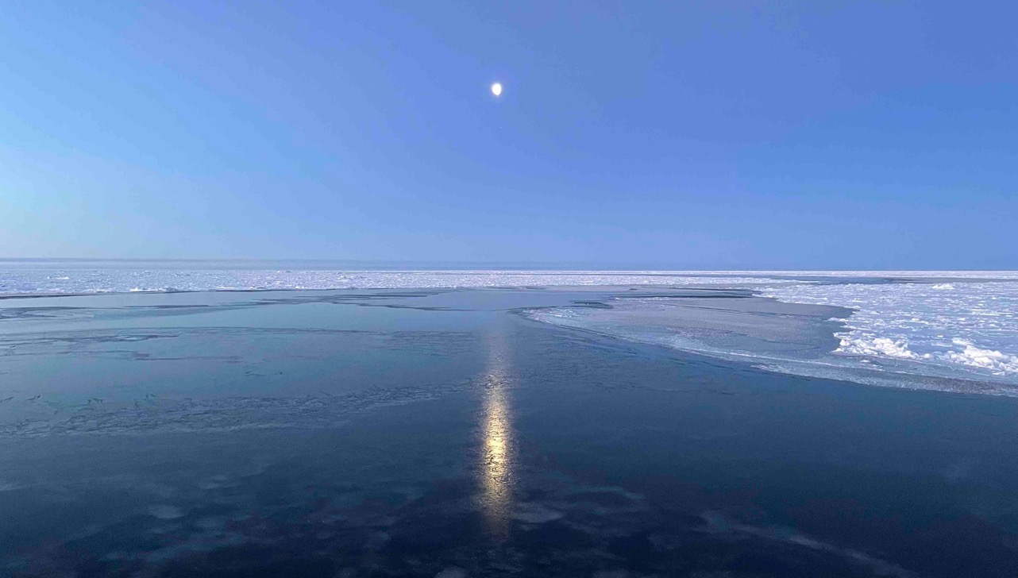
Thank you!

